Slide 1
Design and Analysis of Algorithms Approximation algorithms for NP-complete problems
Haidong Xue
Summer 2012, at GSU

Slide 2
Approximation algorithms for NPC problems
If a problem is NP-complete, there is very likely no polynomial-time algorithm to find an optimal solution
The idea of approximation algorithms is to develop polynomial-time algorithms to find a near optimal solution

Slide 3
Approximation algorithms for NPC problems
E.g.: develop a greedy algorithm without proving the greedy choice property and optimal substructure.
Are those solution found near-optimal?
How near are they?

Slide 4
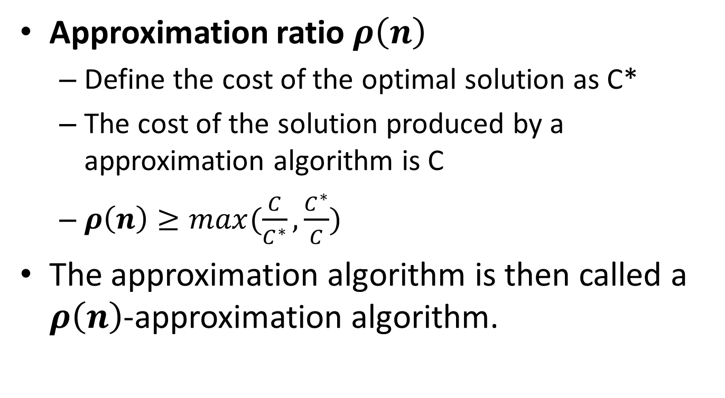
Approximation algorithms for NPC problems
Approximation ratio $ρ\left(n\right)$
Define the cost of the optimal solution as C*
The cost of the solution produced by a approximation algorithm is C
$ρ\left(n\right)≥max(\frac{C}{C^{∗}}, \frac{C^{∗}}{C})$
The approximation algorithm is then called a $ρ\left(n\right)$-approximation algorithm.

Slide 5
Approximation algorithms for NPC problems
E.g.:
If the total weigh of a MST of graph G is 20
A algorithm can produce some spanning trees, and they are not MSTs, but their total weights are always smaller than 25
What is the approximation ratio?
25/20 = 1.25
This algorithm is called?
A 1.25-approximation algorithm

Slide 6

Approximation algorithms for NPC problems
What if $ρ\left(n\right)$=1?
It is an algorithm that can always find a optimal solution

Slide 7
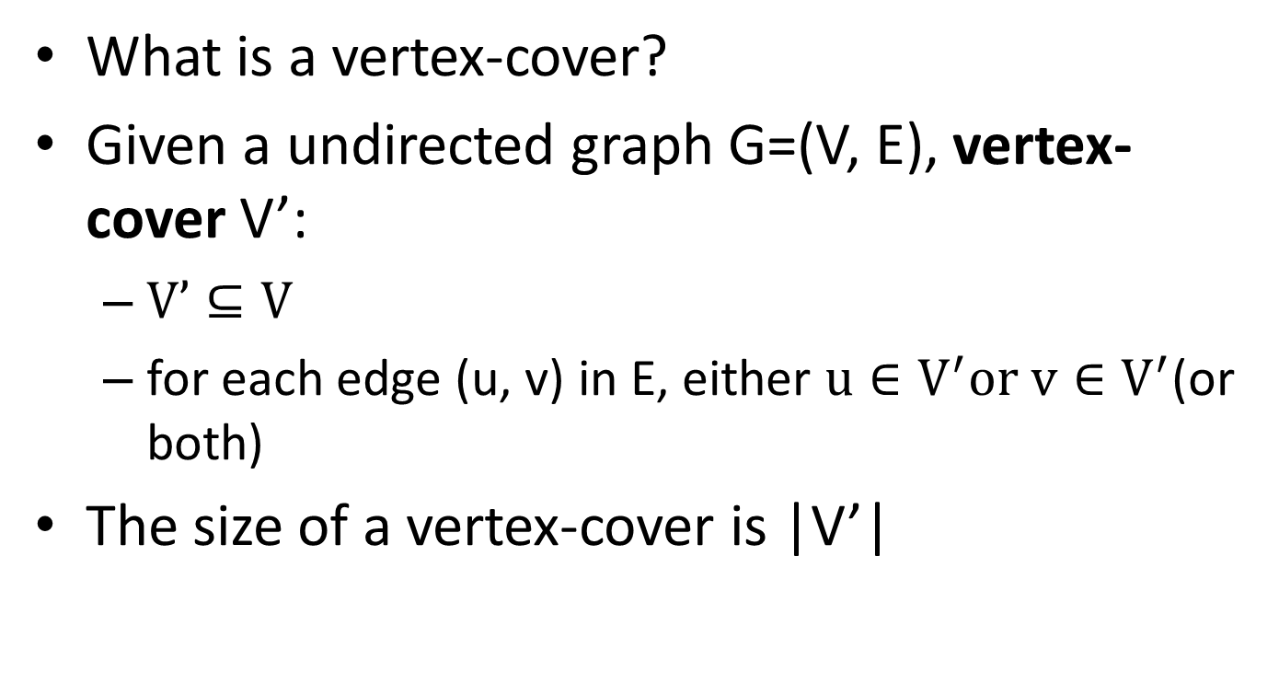
Vertex-cover problem and a 2-approximation algorithm
What is a vertex-cover?
Given a undirected graph G=(V, E), vertex-cover V’:
$V’⊆V$
for each edge (u, v) in E, either $u∈V^{′}or v∈V^{′}$(or both)
The size of a vertex-cover is |V’|

Slide 8
Vertex-cover problem and a 2-approximation algorithm
1
2
3
4
5
6
7
Are the red vertices a vertex-cover?
No. why?
Edges (5, 6), (3, 6) and (3, 7) are not covered by it

Slide 9
Vertex-cover problem and a 2-approximation algorithm
1
2
3
4
5
6
7
Are the red vertices a vertex-cover?
No. why?
Edge (3, 7) is not covered by it

Slide 10
Vertex-cover problem and a 2-approximation algorithm
1
2
3
4
5
6
7
Are the red vertices a vertex-cover?
Yes
What is the size?
4

Slide 11
Vertex-cover problem and a 2-approximation algorithm
1
2
3
4
5
6
7
Are the red vertices a vertex-cover?
Yes
What is the size?
7

Slide 12
Vertex-cover problem and a 2-approximation algorithm
1
2
3
4
5
6
7
Are the red vertices a vertex-cover?
Yes
What is the size?
5

Slide 13
Vertex-cover problem and a 2-approximation algorithm
1
2
3
4
5
6
7
Are the red vertices a vertex-cover?
Yes
What is the size?
3

Slide 14
Vertex-cover problem and a 2-approximation algorithm
Vertex-cover problem
Given a undirected graph, find a vertex cover with minimum size.

Slide 15
Vertex-cover problem and a 2-approximation algorithm
1
2
3
4
5
6
7
A minimum vertex-cover

Slide 16
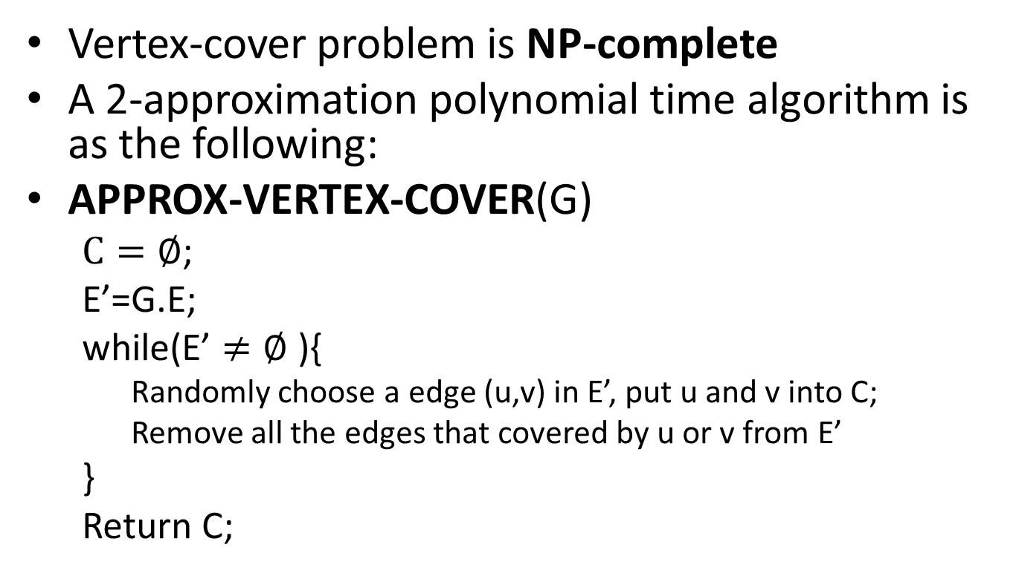
Vertex-cover problem and a 2-approximation algorithm
Vertex-cover problem is NP-complete
A 2-approximation polynomial time algorithm is as the following:
APPROX-VERTEX-COVER(G)
$C=∅$;
E’=G.E;
while(E’ $≠∅$ ){
Randomly choose a edge (u,v) in E’, put u and v into C;
Remove all the edges that covered by u or v from E’
}
Return C;

Slide 17
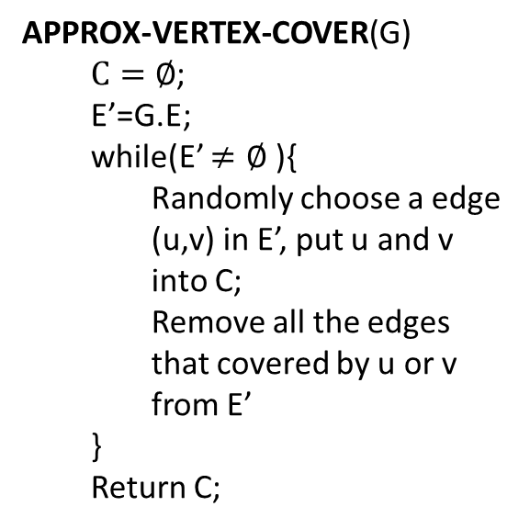
Vertex-cover problem and a 2-approximation algorithm
APPROX-VERTEX-COVER(G)
$C=∅$;
E’=G.E;
while(E’ $≠∅$ ){
Randomly choose a edge (u,v) in E’, put u and v into C;
Remove all the edges that covered by u or v from E’
}
Return C;
1
2
3
4
5
6
7

Slide 18
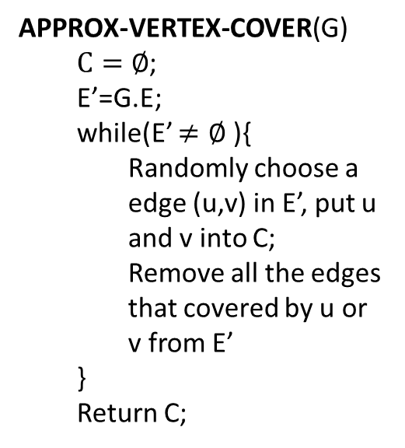
Vertex-cover problem and a 2-approximation algorithm
APPROX-VERTEX-COVER(G)
$C=∅$;
E’=G.E;
while(E’ $≠∅$ ){
Randomly choose a edge (u,v) in E’, put u and v into C;
Remove all the edges that covered by u or v from E’
}
Return C;
1
2
3
4
5
6
7
It is then a vertex cover
Size?
6
How far from optimal one?
Max(6/3, 3/6) = 2

Slide 19
Vertex-cover problem and a 2-approximation algorithm
APPROX-VERTEX-COVER(G)
$C=∅$;
E’=G.E;
while(E’ $≠∅$ ){
Randomly choose a edge (u,v) in E’, put u and v into C;
Remove all the edges that covered by u or v from E’
}
Return C;
1
2
3
4
5
6
7

Slide 20
Vertex-cover problem and a 2-approximation algorithm
APPROX-VERTEX-COVER(G)
$C=∅$;
E’=G.E;
while(E’ $≠∅$ ){
Randomly choose a edge (u,v) in E’, put u and v into C;
Remove all the edges that covered by u or v from E’
}
Return C;
1
2
3
4
5
6
7
It is then a vertex cover
Size?
4
How far from optimal one?
Max(4/3, 3/4) = 1.33

Slide 21
Vertex-cover problem and a 2-approximation algorithm
APPROX-VERTEX-COVER(G) is a 2-approximation algorithm
When the size of minimum vertex-cover is s
The vertex-cover produced by APPROX-VERTEX-COVER is at most 2s

Slide 22
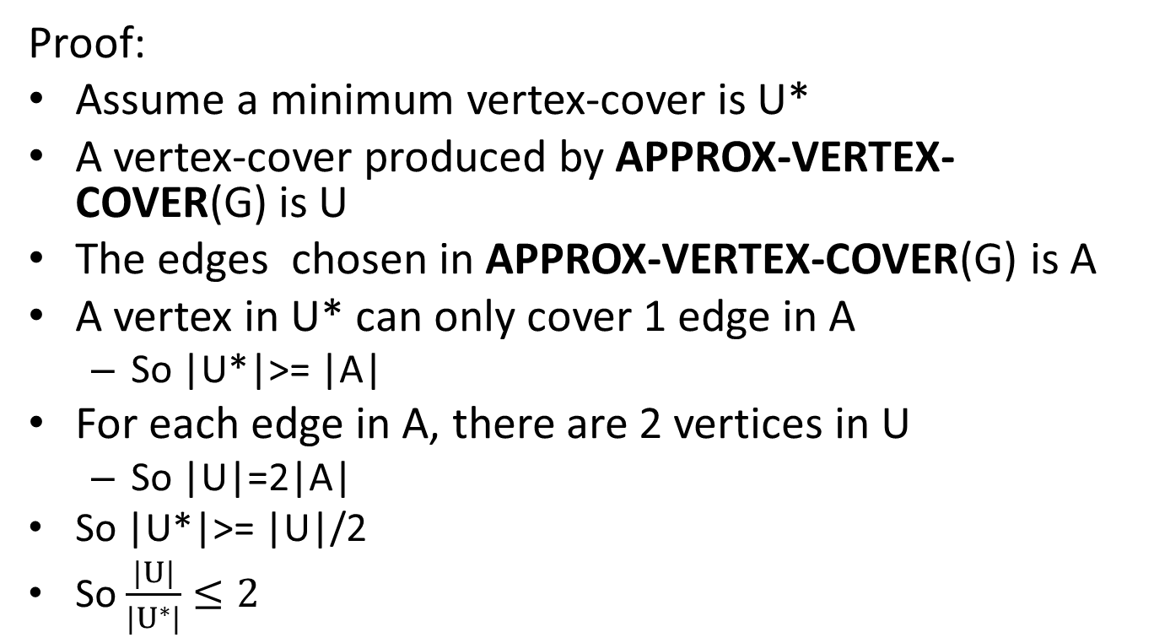
Vertex-cover problem and a 2-approximation algorithm
Proof:
Assume a minimum vertex-cover is U*
A vertex-cover produced by APPROX-VERTEX-COVER(G) is U
The edges chosen in APPROX-VERTEX-COVER(G) is A
A vertex in U* can only cover 1 edge in A
So |U*|>= |A|
For each edge in A, there are 2 vertices in U
So |U|=2|A|
So |U*|>= |U|/2
So $\frac{|U|}{|U^{∗}|}≤2$

Slide 23
Traveling-salesman problem
Traveling-salesman problem (TSP):
Given a weighted, undirected graph, start from certain vertex, find a minimum route visit each vertices once, and return to the original vertex.
1
1
2
30
2
1
20
3
4
3

Slide 24
Traveling-salesman problem
TSP is a NP-complete problem
There is no polynomial-time approximation algorithm with a constant approximation ratio
Another strategy to solve NPC problem:
Solve a special case

Slide 25
Traveling-salesman problem
Triangle inequality:
Weight(u, v) <= Weight(u, w) + Weight(w, v)
E.g.:
If all the edges are defined as the distance on a 2D map, the triangle inequality is true
For the TSPs where the triangle inequality is true:
There is a 2-approximation polynomial time algorithm

Slide 26
Traveling-salesman problem
APPROX-TSP-TOUR(G)
Find a MST m;
Choose a vertex as root r;
return preorderTreeWalk(m, r);

Slide 27
Traveling-salesman problem
Can we apply the approximation algorithm on this one?
1
1
2
30
2
1
20
3
4
3
No. The triangle inequality is violated.

Slide 28
Traveling-salesman problem
Use Prim’s algorithm to get a MST
a
d
e
b
f
g
c
h
For any pair of vertices, there is a edge and the weight is the Euclidean distance
Triangle inequality is true, we can apply the approximation algorithm

Slide 29
Traveling-salesman problem
Use Prim’s algorithm to get a MST
a
d
Choose “a” as the root
e
b
f
g
Preorder tree walk
c
a
b
c
h
d
e
f
g
h
For any pair of vertices, there is a edge and the weight is the Euclidean distance
Triangle inequality is true, we can apply the approximation algorithm

Slide 30
Traveling-salesman problem
Use Prim’s algorithm to get a MST
a
d
Choose “a” as the root
e
b
f
g
Preorder tree walk
c
a
b
c
h
d
e
f
g
h
The route is then…
Because it is a 2-approximation algorithm
A TSP solution is found, and the total weight is at most twice as much as the optimal one

Slide 31
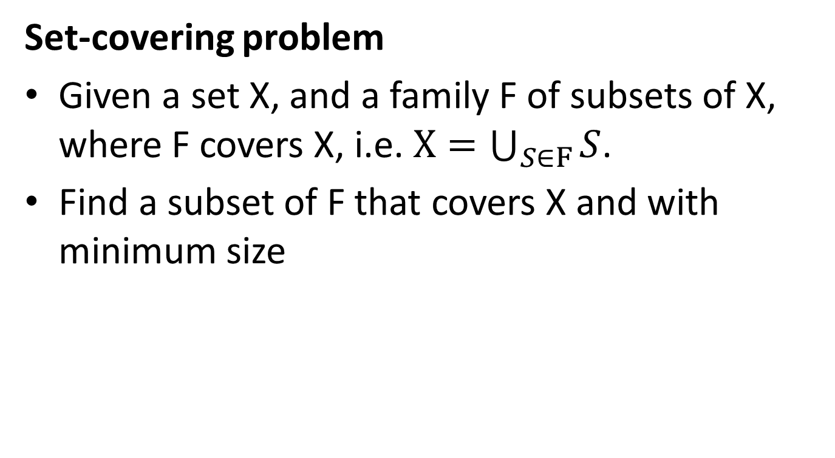
The set-covering problem
Set-covering problem
Given a set X, and a family F of subsets of X, where F covers X, i.e. $X=\bigcup_{S∈F}{S}$.
Find a subset of F that covers X and with minimum size

Slide 32
The set-covering problem
X:
a
b
c
h
d
e
{f1, f3, f4} is a subset of F covering X
F:
{f1, f2, f3, f4} is a subset of F covering X
f1:
a
b
f5:
a
{f2, f3, f4, f5} is a subset of F covering X
f2:
b
f3:
c
h
Here, {f1, f3, f4} is a minimum cover set
f4:
d
e

Slide 33

The set-covering problem
Set-covering problem is NP-complete.
If the size of the largest set in F is m, there is a $\sum_{i=1}^{m}{1/i}$ - approximation polynomial time algorithm to solve it.

Slide 34
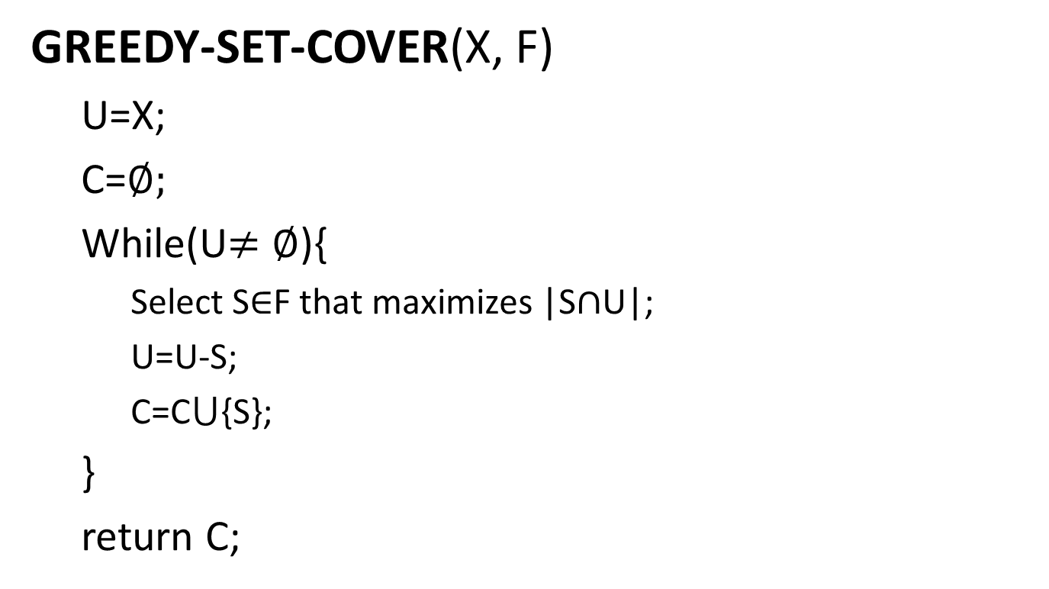
The set-covering problem
GREEDY-SET-COVER(X, F)
U=X;
C=$∅;$
While(U$≠$ $∅$){
Select S$∈$F that maximizes |S$∩$U|;
U=U-S;
C=C$⋃${S};
}
return C;

Slide 35
The set-covering problem
We can choose from f1, f3 and f4
X:
Choose f1
a
b
c
h
We can choose from f3 and f4
Choose f3
We can choose from f4
d
e
Choose f4
F:
f1:
a
b
a
b
c
h
d
e
U:
f2:
b
f3:
c
h
C:
f1:
a
b
f3:
c
h
f4:
d
e
f4:
d
e
f5:
a

Slide 36
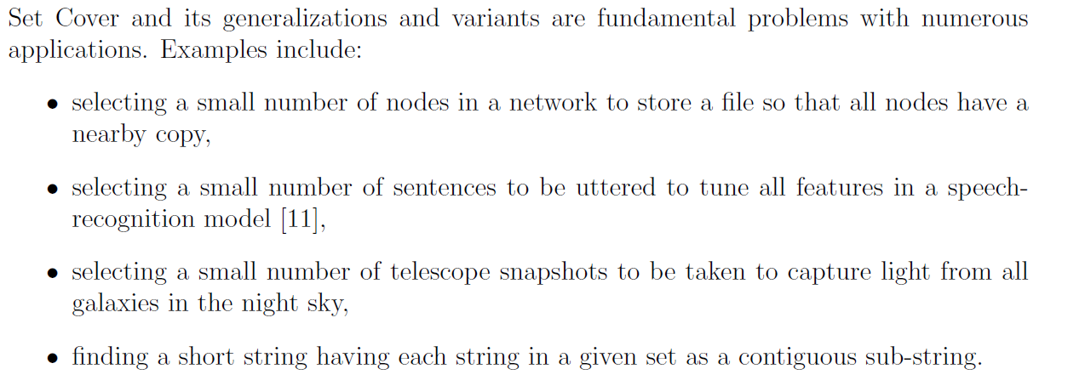

Slide 37
Summary
P problems
NP problems
NP-complete problems
NP-Hard problems
The relation between P and NP
Polynomial approximation algorithms

